Slide 1
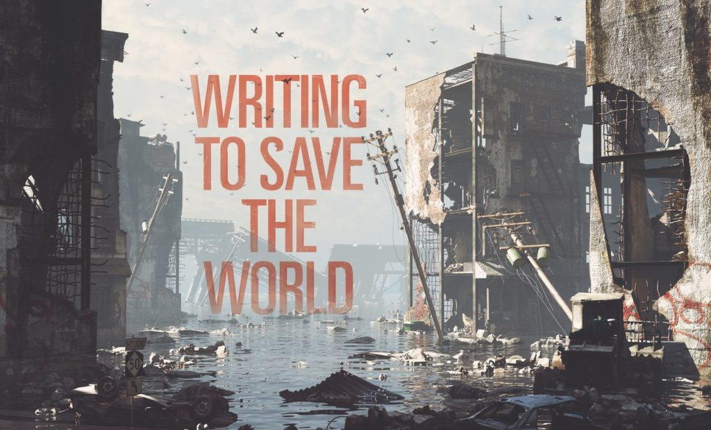
Preparing Teachers to Support Digital / Online Activism
D-LITE Roundtable Session
NCTE 2020
Case Study: Climate Crisis
Allen Webb
Western Michigan University

Slide 2
1. Foster Inquiry into Topics that Matter
Imagining what future may hold, not only scientifically, but also socially, politically, and at interpersonal levels.
Researching claims about climate effects.
Considering ethical questions
Researching ways to prevent impacts, including personal, community, state, and global levels.
Rewriting/reimagining settings and characters in traditional literature
Inspiring persuasive, place-based & creative writing.

Slide 3
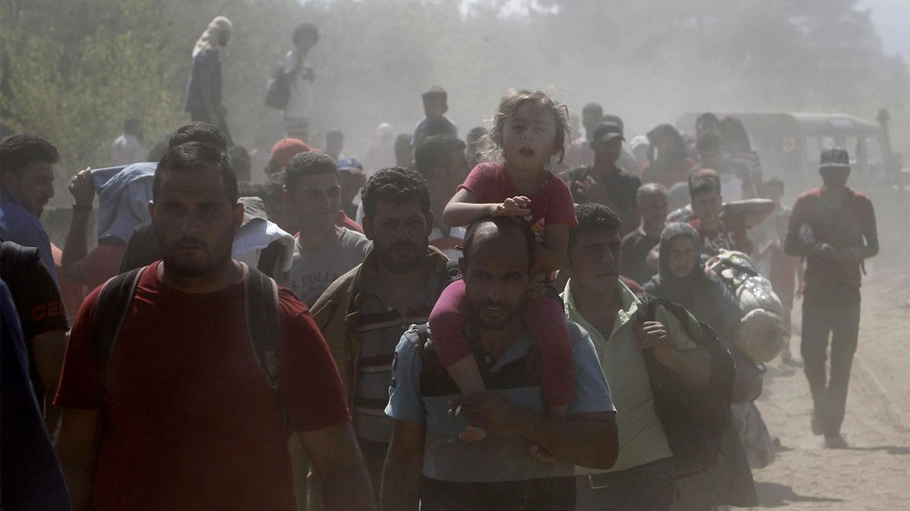
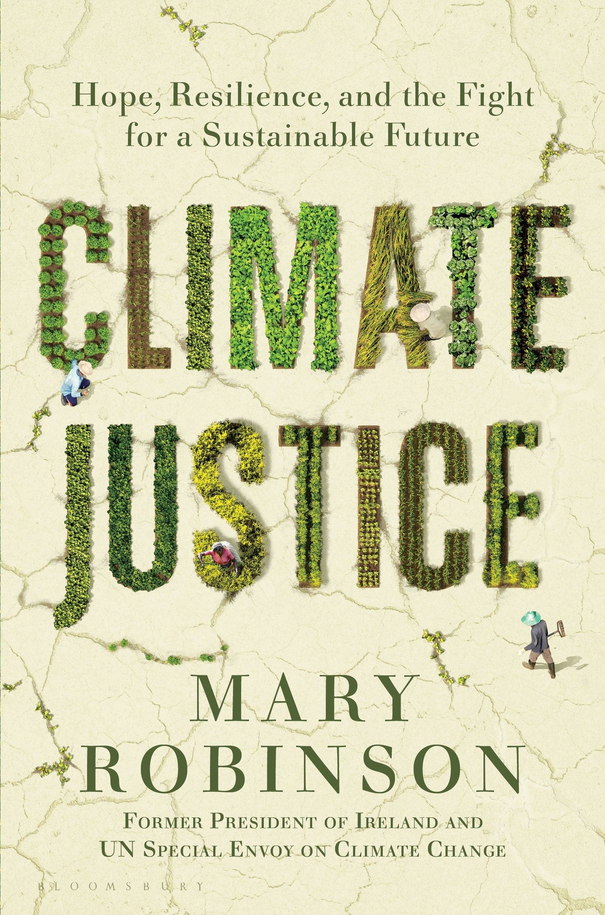
2. Examine Issues of Justice
Who caused the crisis? Who suffers first and most?
Who knew and could have acted? Who fostered denial?
How will decisions of the older generation impact the young?
What is it like to be a climate victim or refugee? What responsibility do we have to victims and refugees?
What should be America’s role in the global community?
What responsibilities do humans have to animals, plants, and the natural world?
What would a just and fair approach to addressing the climate emergency look like?

Slide 4

3. Make Activism Part of Teacher Education
Read about and meet teachers engaged in activist teaching on climate crisis
Studied young people and groups working to address climate change
Joined Fridays for Future and global school strike
Learn about activism - This is an Uprising: How Nonviolent Revolt is Shaping the 21st C, Mark and Paul Engler
No Easy Walk (video) & read: King's Letter From the Birmingham Jail, The Time for Direct Action on Climate Change in Now, Shut It Down, Direct Action, 198 Methods of Non-Violent Direct Action.
How the Active Many Can Overcome the Ruthless Few by Bill McKibben

Slide 5

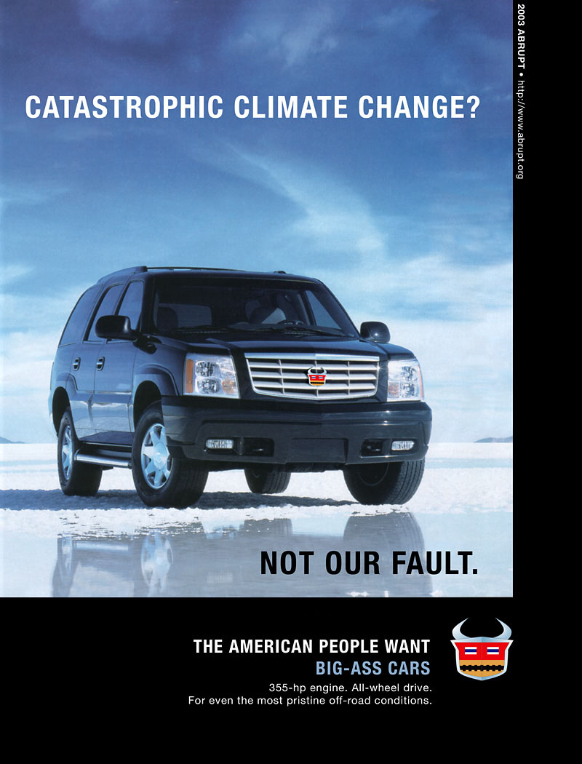
4. Use Online Tools to Communicate Broadly
Blogs, wikis, websites, Snapchat, Facebook
Climate crisis “culture jams” Memes Culture Jamming, samples, Brandalism
Online climate change cook book for young people

Slide 6
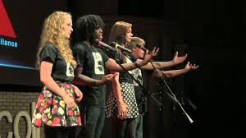
5. Use Digital Tools to Support Local Actions
Shared poetry, short stories, & persuasive essays
Community discussions about climate change
Wrote “Climate Manifestos”
Spoke at community climate protests
Climate change “teach-in”
Designed climate action projects
Organized community film/discussion/tabling on refugees
Showed a climate change documentary at school and led panel after
Examined how future careers can address climate change
Protested tree cutting and planted trees

Slide 7
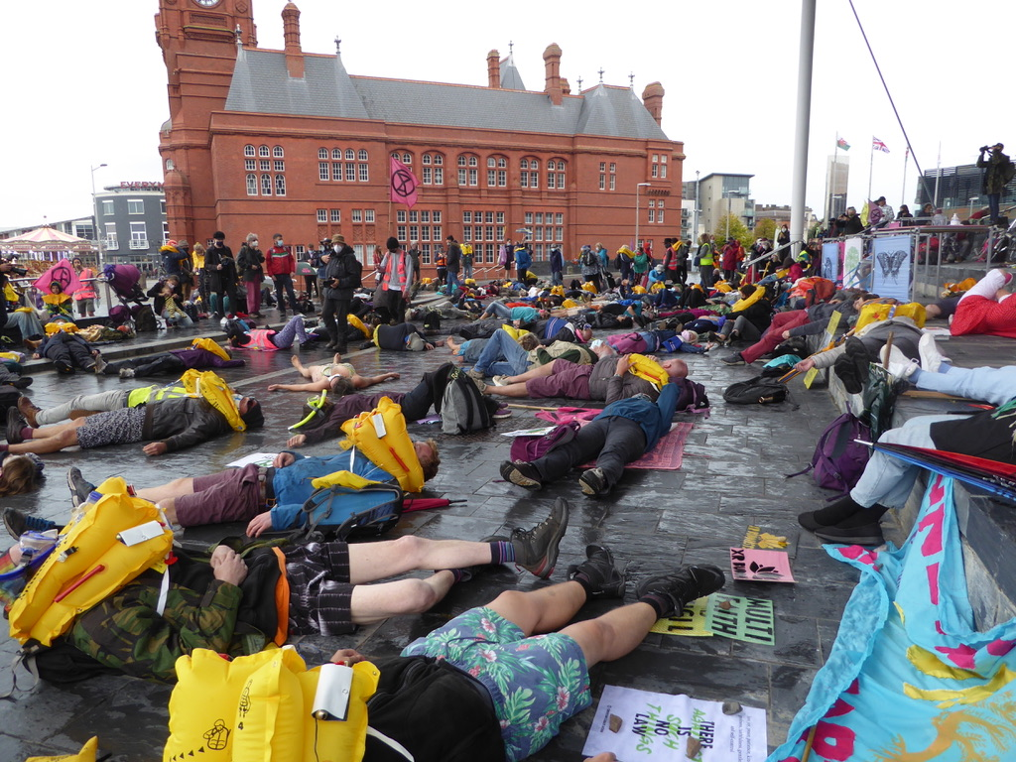
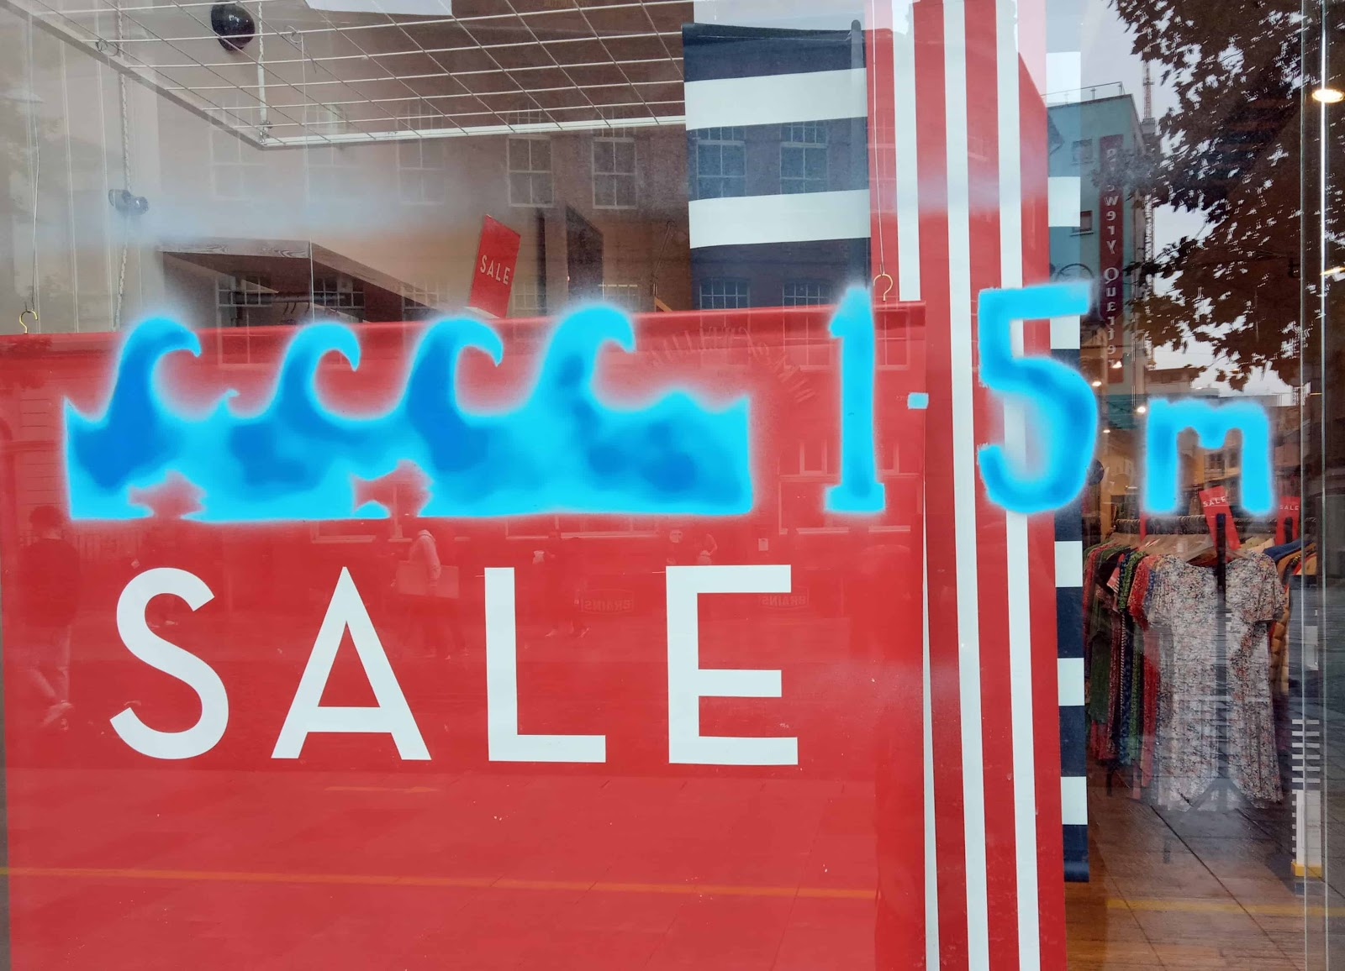
6. Use Imagination and Creativity
In City at risk of sea-level rise…
“Drown-In”
Chalk Waves on Buildings

Slide 8
